Slide 1
Clustering Toronto Neighborhoods
Using Machine learning

Slide 2
Background
Toronto is the capital of Ontario and is the most populous city in Canada with a population of 2,731,571 in 2016.
Toronto is host to various cuisines from all over the world like Chinese, Vietnamese, Korean, Indian, Italian etc.
There are neighborhoods where the dominant cuisine is based on the demographics of the people living there.
Certain neighborhoods are famous for certain types of cuisines. For example, Chinatown is famous for Chinese cuisine, Koreatown is famous for Korean cuisine and so on.

Slide 3


Problem
Tourists who are new to Toronto need help in deciding what neighborhood to visit in order to try the cuisine it is famous for.
Tourist guides find it helpful if they know what neighborhoods are popular for specific cuisines so that they can recommend them to the tourists.

Slide 4
Target Audience
Tourists to Toronto would be interested in finding the neighborhoods in which their favorite cuisine is famous.
Tourist guides find it helpful in recommending those neighborhoods based on the interests of their clients.
Entrepreneurs can find what the dominant cuisine of a neighborhood is in order to decide if they want to establish restaurant of a different cuisine to avoid competition or choose a different neighborhood.

Slide 5
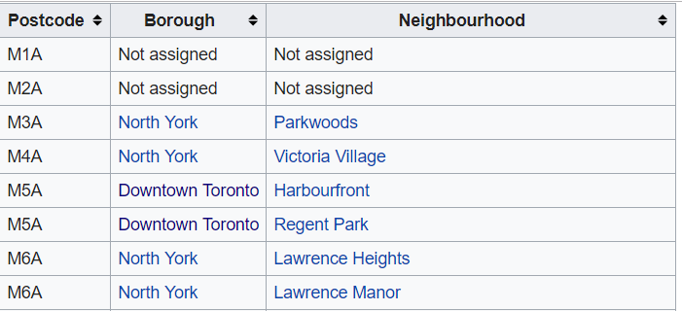
Data Sources
Data about the boroughs, neighborhoods and postal codes in Toronto taken from https://en.wikipedia.org/wiki/List_of_postal_codes_of_Canada:_M.

Slide 6
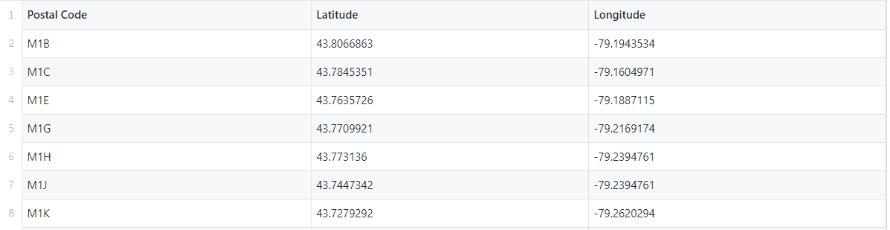
Data Sources
The coordinates of each neighborhood according to its postal code is given in https://github.com/kamis1r/Coursera_Capstone/blob/master/Geospatial_Coordinates.csv

Slide 7


Foursquare API
Details of restaurants can be obtained by refining location data given by Foursquare API.
A request is made to tabulate all venues in a neighborhood.
Details of the venue like the name ,location and, category of the restaurant are listed.

Slide 8
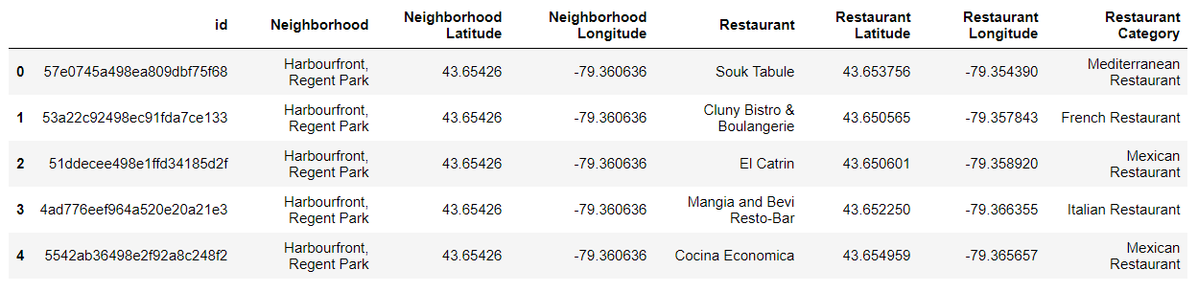
Venue Recommendations using Foursquare API

Slide 9
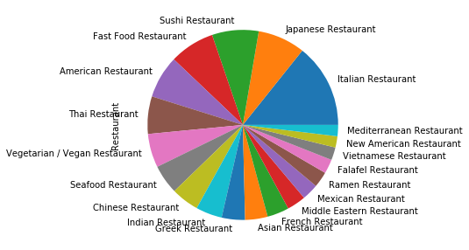
Exploratory Data Analysis
A pie chart that represents the share in popularity of the top 20 popular cuisines of Toronto.
Italian is the most popular followed by Japanese.
The least popular cuisine among all cuisines is Afghan

Slide 10
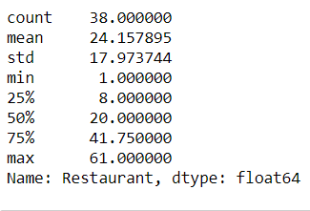
Descriptive statistics
The neighborhoods with the highest number the restaurants are Chinatown, Grange Park and Kensington Market with 61 restaurants.
The neighborhoods with the least number of restaurants are Roselawn, Lawrence Park with only 1 restaurant in each.

Slide 11
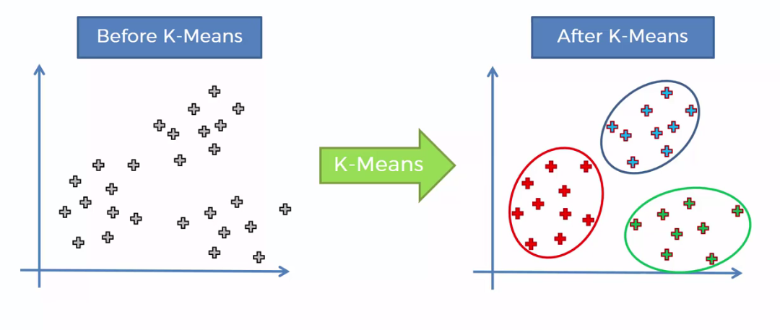
Clustering
We use the K-means clustering algorithm to cluster the neighborhoods based on the frequency of the top 7 cuisines in the neighborhoods.
The number of clusters is selected beforehand to be 7.
K-means is appropriate for this problem because it is a type of unsupervised clustering where we do not know the distinguishing factors of the resultant clusters or groups beforehand.

Slide 12

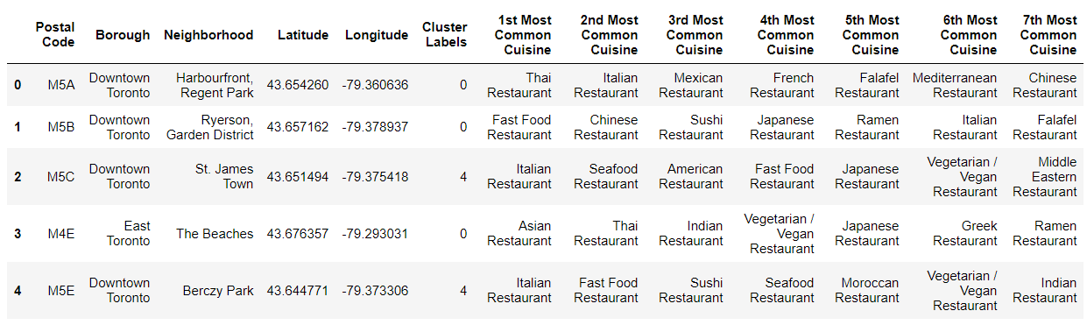


After applying clustering

Slide 13
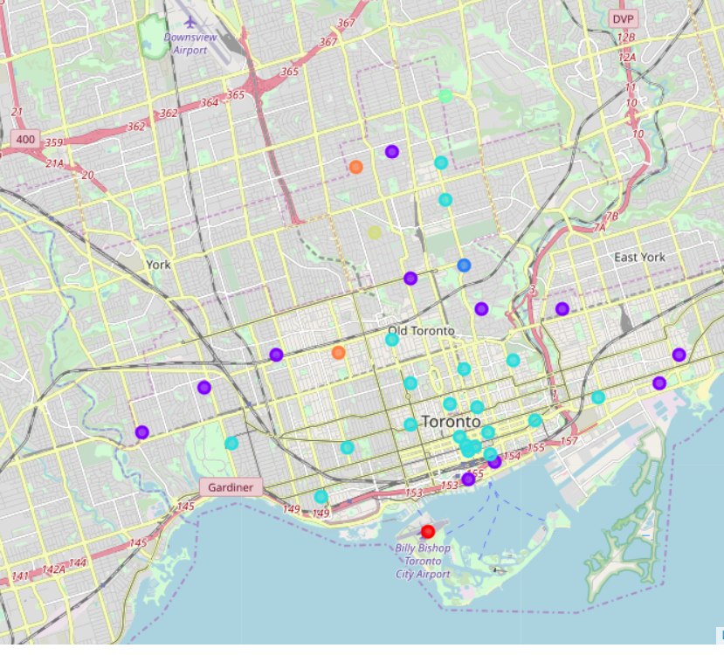
Results
7 clusters are produced that have similar cuisines within a cluster.
The clusters of neighborhoods are visualized on a map with each color indicating a specific cluster using the folium package.

Slide 14
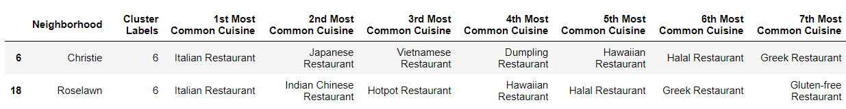
Discussion
In Cluster 6, we can see how the K-means clustering algorithm successfully grouped the neighborhoods of Christie and Roselawn since they have similar cuisines like Italian, Hawaiian, and Greek.

Slide 15
Conclusion
In this study, I analyzed the popular cuisines of different neighborhoods in Toronto using the foursquare API and clustered the neighborhoods using a machine learning algorithm called k-means clustering.
I used the coordinates of the neighborhoods from a different table to visualize the clusters on a folium map.
These mapped clusters can be very useful for tourist guides to recommend their clients what neighborhoods in Toronto to visit to get a taste of a cuisine of their choice.
Restaurant entrepreneurs can examine the clusters closely to look at the dominant cuisines of a neighborhood and make financial decisions.

